Slide 1
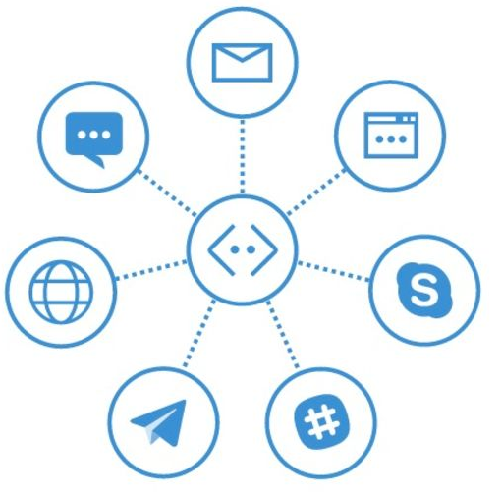

Testing Bots
Mithun Prasad, PhD miprasad@Microsoft.com

Slide 2

Testing Bots
What Should We Test?
How do you test a bot?
Mocking
Unit/Functional/Load Testing
- Channel Testing

Slide 3

Unit Tests

Slide 4
Unit Tests
Mock out the Bot Framework
Perform Unit Testing by reusing the Bot Builder code
DialogTestBase.cs
FiberTestBase.cs
MockConnectorFactory.cs
Runs locally

Slide 5
What is Mocking?
Simulate the behaviour of real objects
Used in unit testing
Used when the unit being tested has external dependencies
To isolate the behaviour of the object you want to test, the other objects will be replaced by mocks that simulate the behaviour of the real objects
Useful if the real objects are impractical to incorporate into the unit test
Moq for Bots - mocking framework for .NET

Slide 6
LAB: BotsUnitTestingLab

Slide 7
Testing a Hosted Bot

Slide 8
Testing Channels
Host the Bot service on a public URL endpoint
When designing / building / testing your code, you don’t always want to have to redeploy
Redeploying means paying hosting costs

Slide 9
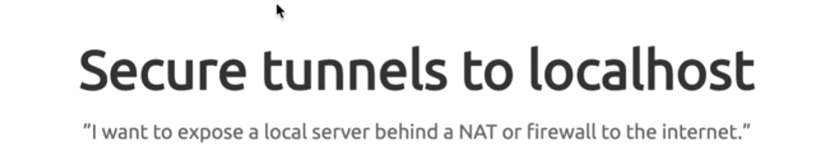
Ngrok

Slide 10

What is Ngrok?
Adam ngrok
John
Tunnel

Slide 11
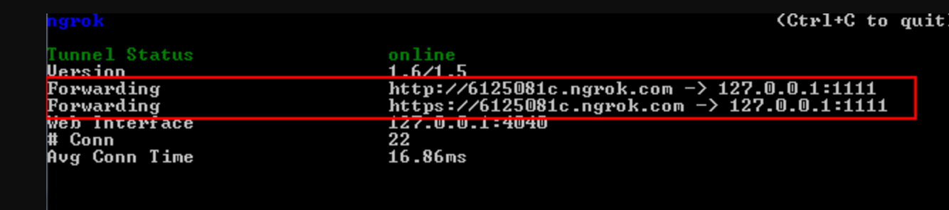
Forwarding
ngrok http 1111

Slide 12
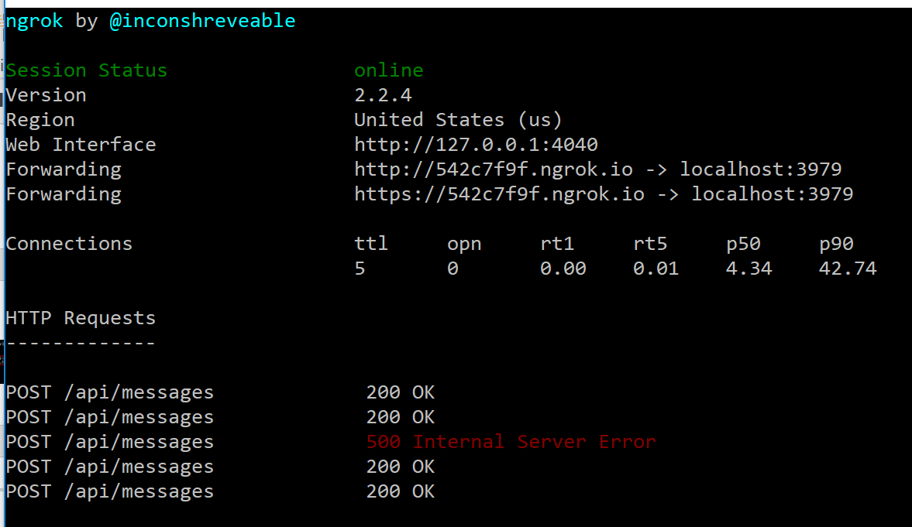
Forwarding
Given the bot is being hosted on localhost:3979, use ngrok to expose it to public internet
ngrok.exe http 3979 -host-header="localhost:3979"
The forwarding url is the
public endpoint for the
bot service

Slide 13
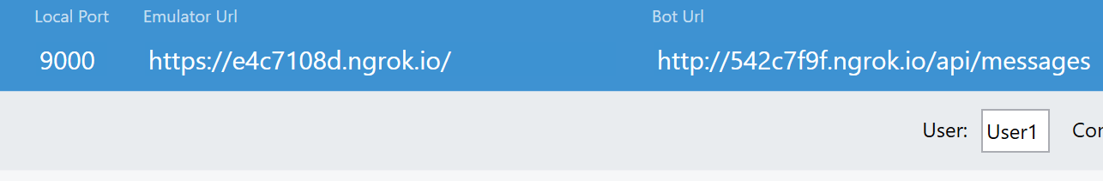
Testing Emulator on Public Endpoints
The forwarding public urls from ngrok can be used in the emulator as shown below

Slide 14
LAB: BotsNgrokLab

Slide 15
Direct Line

Slide 16
Talk Directly
A rich list of channels are supported. But what do you do when the channels provided aren’t quite enough?
Direct Line!
Direct Line is a REST API for the bot framework that allows it’s users to create their own integrations
Example: If you have a mobile app that you directly want to integrate a chat bot into. You cannot make your app a channel!

Slide 17
Authentication
Call the Bot directly from a custom application to test authentication
Allows you to authenticate a user in your application and securely communicate with the Bot as that user
Direct Line API requests can be authenticated either by using a secret that you obtain from the Direct Line channel configuration page in the Bot Framework Portal

Slide 18
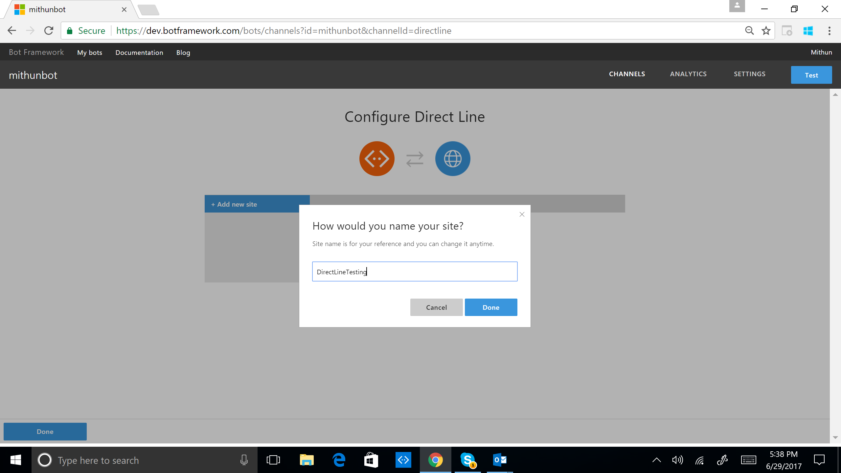
Direct Line Configuration

Slide 19
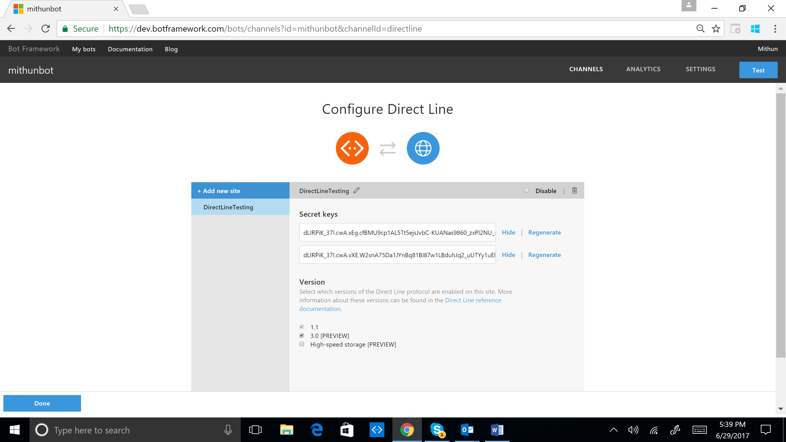
Direct Line Configuration

Slide 20
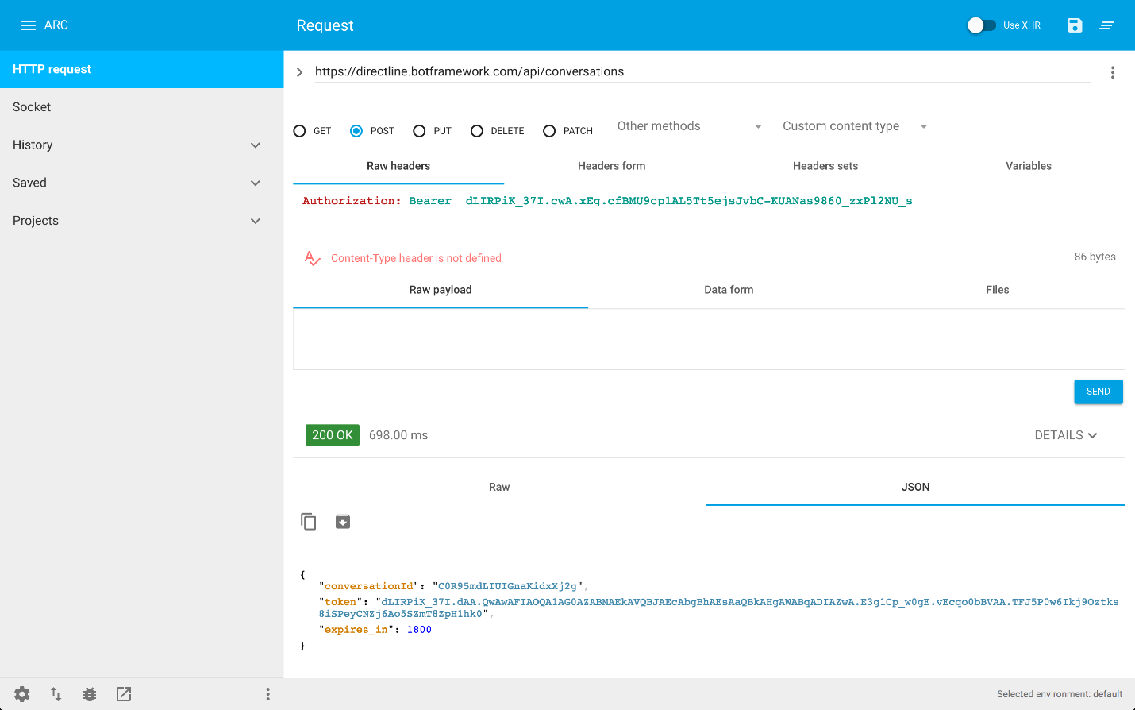
Start a Conversation

Slide 21
Direct Line Concepts
Starting a conversation
Sending messages
Receiving messages
End conversation

Slide 22
LAB: BotsDirectLineLab

